Slide 1
Human Computer Interaction
The computer Part V
DEVICES FOR VIRTUAL REALITY AND 3D INTERACTION
CS 8th Semester

Slide 2
Virtual Reality and 3D Interaction
Virtual reality (VR) refers to a computer-generated simulation in which a person can interact within an artificial three-dimensional environment using electronic devices, such as special goggles with a screen or gloves fitted with sensors. In this simulated artificial environment, the user is able to have a realistic-feeling experience.
3D interaction is a form of human-machine interaction where users are able to move and perform interaction in 3D space.

Slide 3
Positioning in 3D space
Virtual reality systems present a 3D virtual world. Users need to navigate through these spaces and manipulate the virtual objects they find there.
Navigation is not simply a matter of moving to a particular location, but also of choosing a particular orientation. In addition, when you grab an object in real space, you don’t simply move it around, but also twist and turn it. For example when opening a door. Thus the move from mice to 3D devices usually involves a change from two degrees of freedom to six degrees of freedom, not just three.
The 3D mouse
six-degrees of movement: x, y, z + roll, pitch, yaw

Slide 4
pitch, yaw and roll
yaw
roll
pitch

Slide 5
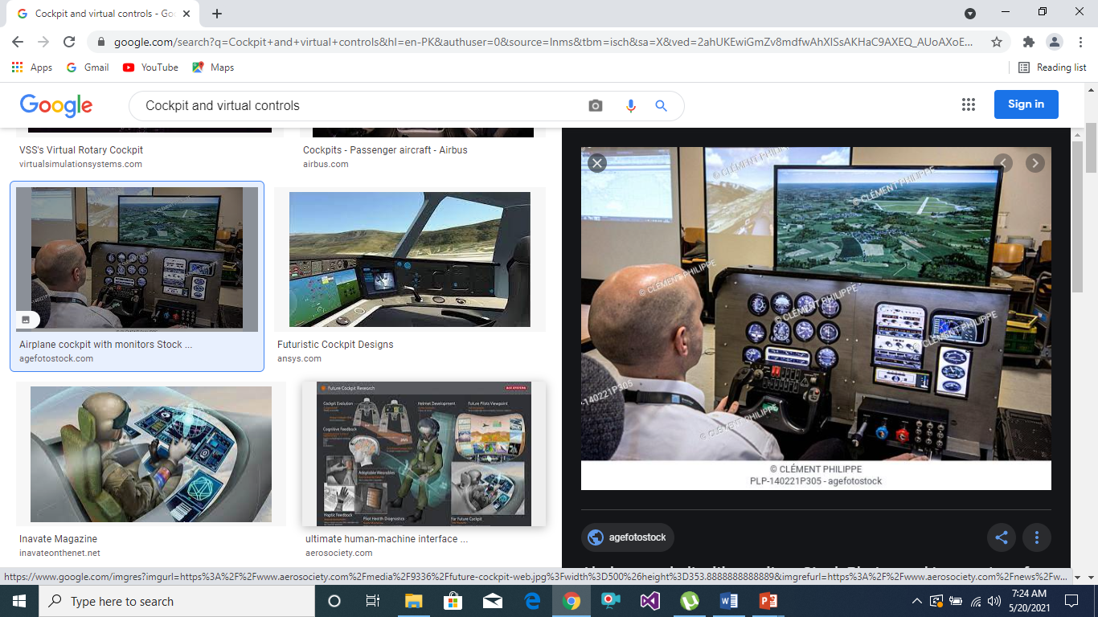
Cockpit and virtual controls

Slide 6
Cockpit and virtual controls
Helicopter and aircraft pilots already have to navigate in real space. Many arcade games and also more serious applications use controls modeled on an aircraft cockpit to ‘fly’ through virtual space. However, helicopter pilots are very skilled and it takes a lot of practice for users to be able to work easily in such environments.

Slide 7

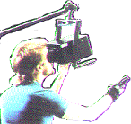

VR headsets
small TV screen for each eye
slightly different angles
3D effect

Slide 8
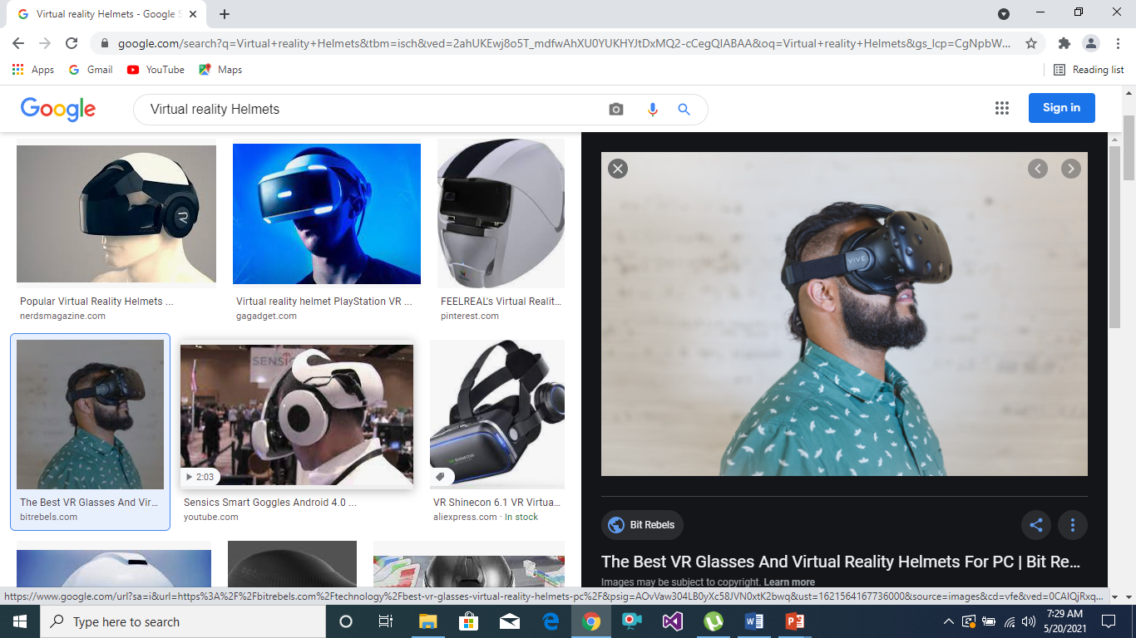
Virtual helmets

Slide 9
Virtual reality Helmets
The helmets or goggles worn in some VR systems have two purposes:
They display the 3D world to each eye.
They allow the user’s head position to be tracked.
We will discuss the former later when we consider output devices. The head tracking is used primarily to feed into the output side. As the user’s head moves around the user ought to see different parts of the scene. However, some systems also use the user’s head direction to determine the direction of movement within the space and even which objects to manipulate (rather like the eye gaze systems).
You can think of this rather like leading a horse in reverse. If you want a horse to go in a particular direction, you use the reins to pull its head in the desired direction and the horse follows its head.

Slide 10
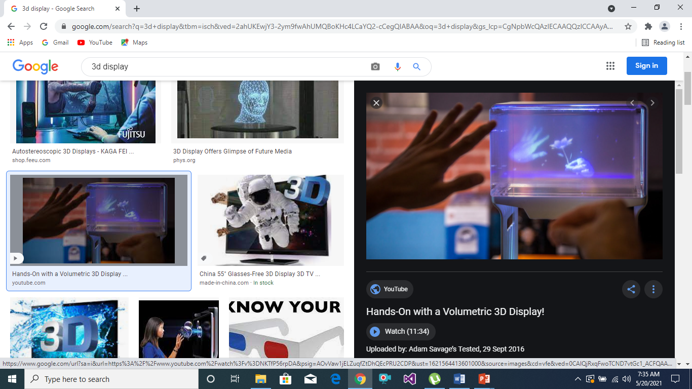
3D Display

Slide 11
3D displays
desktop VR
ordinary screen, mouse or keyboard control
perspective and motion give 3D effect
seeing in 3D
use stereoscopic vision
VR helmets
screen plus shuttered specs, etc.

Slide 12
3D displays
Just as the 3D images used in VR have led to new forms of input device, they also require more sophisticated outputs. Desktop VR is delivered using a standard computer screen and a 3D impression is produced by using effects such as shadows, occlusion (where one object covers another) and perspective. This can be very effective and you can even view 3D images over the World Wide Web using a VRML
(Virtual reality markup language) enabled browser.

Slide 13
VR motion sickness
Time delay
move head … lag … display moves
conflict: head movement vs. eyes
Depth perception
headset gives different stereo distance
but all focused in same plane
conflict: eye angle vs. focus
Conflicting cues => sickness
helps motivate improvements in technology

Slide 14
VR motion sickness
We all get annoyed when computers take a long time to change the screen, pop up a window, or play a digital movie. However, with VR the effects of poor display performance can be more serious.
In real life when we move our head the image our eyes see changes accordingly. VR systems produce the same effect by using sensors in the goggles or helmet and then using the position of the head to determine the right image to show.

Slide 15
simulators and VR caves
scenes projected on walls
realistic environment
hydraulic rams!
real controls
other people

Slide 16
Simulators and VR caves
Because of the problems of delivering a full 3D environment via head-mounted displays, some virtual reality systems work by putting the user within an environment where the virtual world is displayed upon it. The most obvious examples of this are large flight simulators – you go inside a mock-up of an aircraft cockpit and the scenes you would see through the windows are projected onto the virtual windows.

